Slide 1
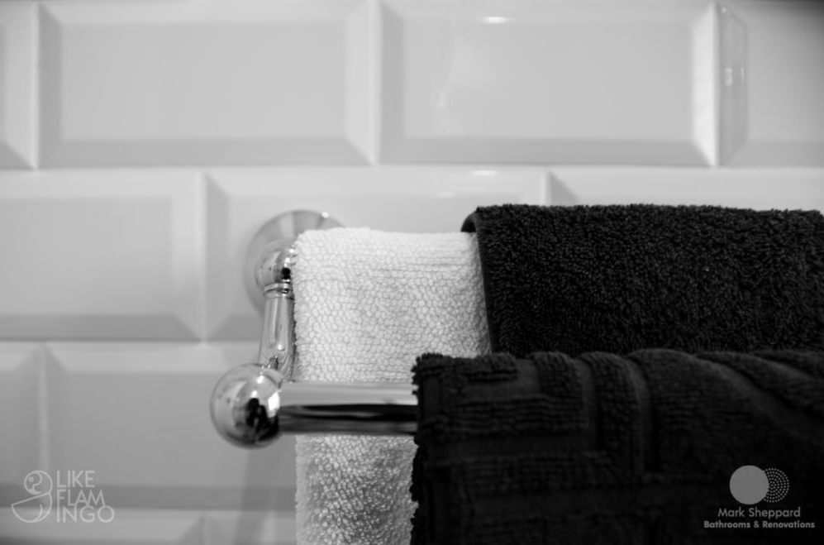
Mark Sheppard Bathrooms
WARRANTY INFORMATION
Karen and Geoff
5 Angles Court Nichols

